Slide 1
FIFA World Cup Analysis

Slide 2
Introduction
With FIFA is in the blood of many people of the world. You are tasked to tell the story of unsung analysts who put great efforts to provide accurate data to answer every question of fans. The FIFA World Cup is a global football competition contested by the various football-playing nations of the world. It is contested every four years and is the most prestigious and important trophy in the sport of football.

Slide 3
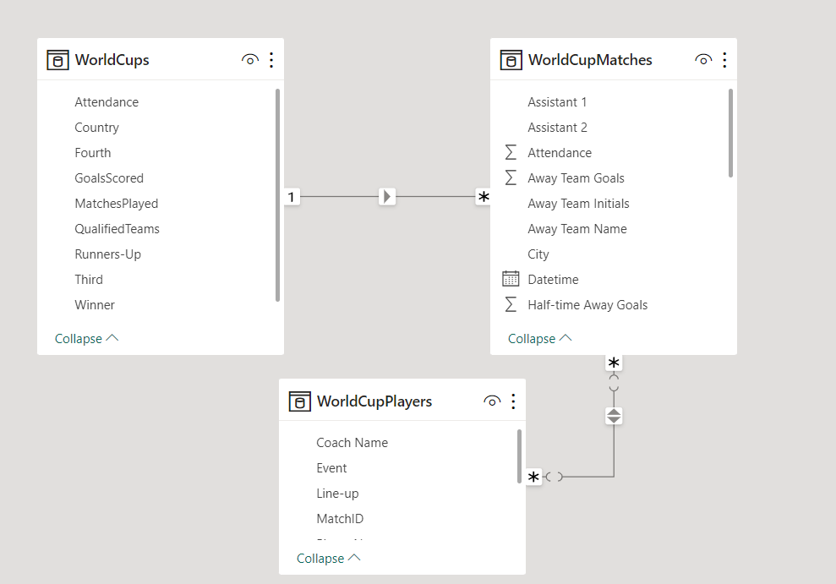
Details of data

Slide 4
Main Graphs
Attendance by Year
Matches with Highest Attendance
Stadiums with Highest Average Attendance
Teams with Most World Cup Wins

Slide 5
Mock – up Dashboard
FIFA World Cup Analysis
Page 1
Page 2
Page 3

Slide 6
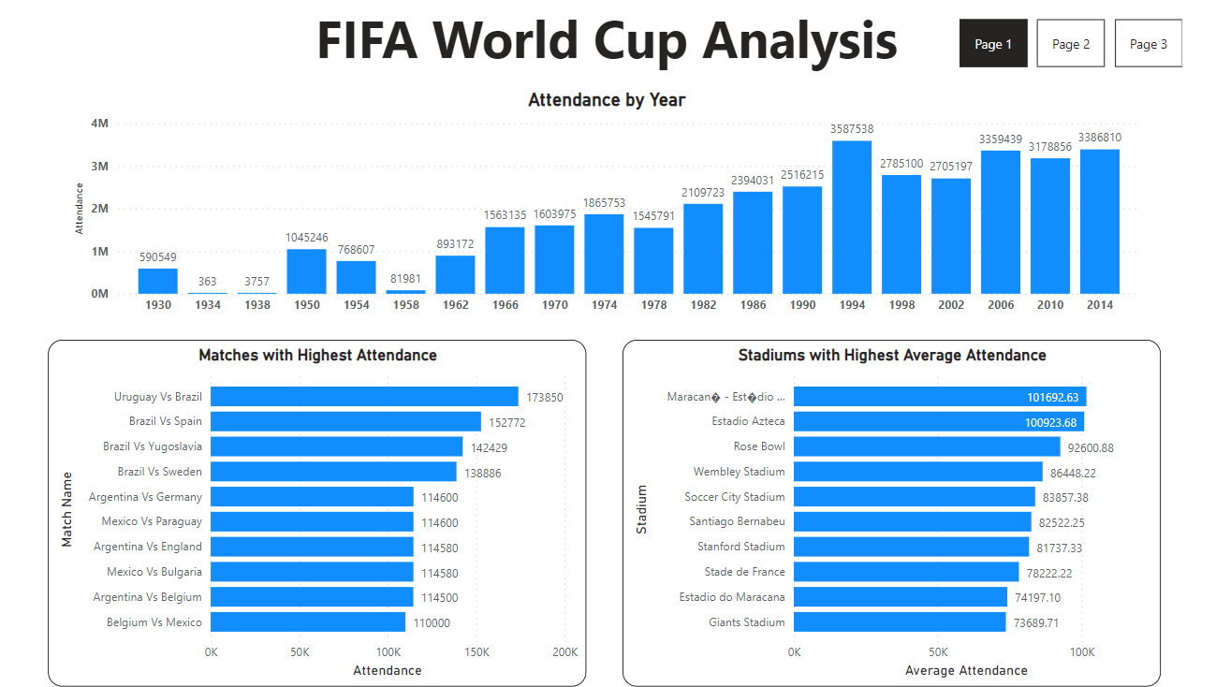
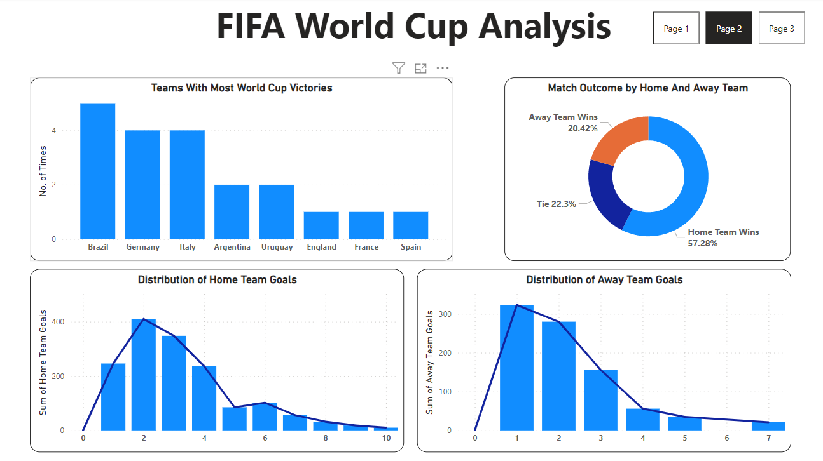
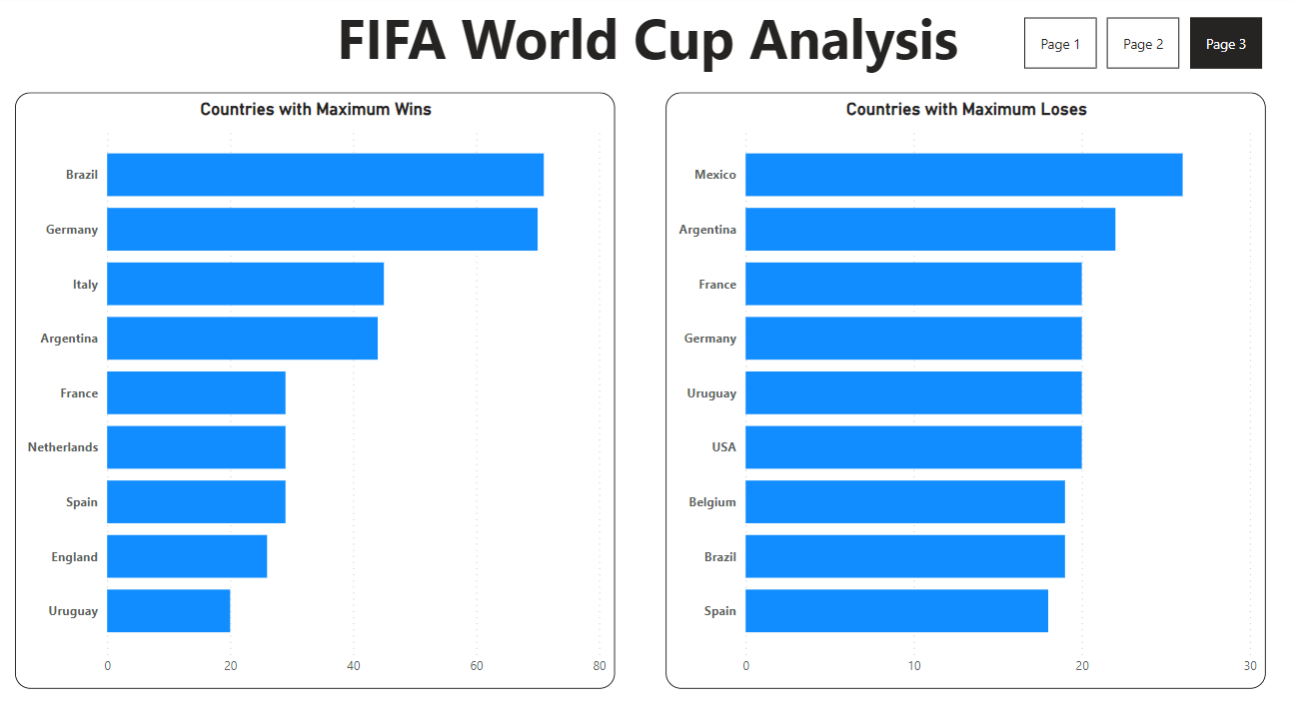
My Design

Slide 7
Thank You

